Slide 1
Systrace UI
A real-time system monitoring dashboard

Slide 2
Introduction
Systrace UI is a real-time Linux system monitoring dashboard that visualizes CPU, memory, disk activity, processes, and system load by reading data directly from the /proc virtual filesystem.
Linux provides system information through /proc, a virtual filesystem.
Tools like htop, top, gnome-system-monitor use the same source.
This project replicates similar functionality using a modern web interface.

Slide 3
Key Features
Real-time Resource Monitoring:
  CPU usage
  Memory usage (used, free, cached, buffers, swap)
  Disk I/O (read/write KB/s)
  Load averages & uptime
Process Management:
  Live process table
  CPU% & memory (RSS) per process
  Filter by name / PID / UID
  Kill any running processes from UI
Modular Interactive UI:
  TailwindCSS-based design
  Recharts for dynamic graphs
  Smooth updates every 2 seconds
Modular Backend:
  REST APIs
  Reads system data directly from /proc
  Kill processes using child_process.exec

Slide 4
Tech Stack
Frontend:
React: For building the user interface.
Vite: For fast development and build processes.
TailwindCSS: For styling.
Recharts: For CPU and Memory graphs.
Fetch API: For backend calls
Backend:
Node.js: For server-side logic.
Express: For building RESTful APIs.
fs/promises: To read /proc files.
child_process.exec: To manage processes

Slide 5
Flow Diagram
User opens Dashboard
React UI
Starts 2 sec. polling
Backend API
receives requests
Reads /proc files
(CPU, Disk, Memory, Processes)
Backend computes
CPU%, Mem%, Disk I/O,
Process stats
Returns JSON
response
React updates UI:
Cards, Tables and Graph

Slide 6
Sequence Diagram
Kill process Operation
User
Frontend
Backend
LINUX Kernel
/proc Filesystem
Click Kill
POST /kill
exec(“kill –TERM PID”)
Signal
JSON Success
Show popup

Slide 7
API Endpoints
Method | Route | Description
GET | /api/cpu | CPU usage statistics
GET | /api/memory | Memory usage stats
GET | /api/processes | List of active processes
POST | /api/processes/:pid/kill | Kill a process
GET | /api/summary | Load averages & uptime
GET | /api/disk | Disk I/O rates

Slide 8
How /proc is Used?
/proc/stat
provides system-wide CPU statistics and performance metrics
/proc/meminfo
displays detailed memory usage information for the entire system
/proc/[pid]/stat
contains process-specific status and resource utilization data
/proc/[pid]/status
offers human-readable process information and state details
/proc/diskstats
tracks disk I/O statistics for all block devices
/proc/uptime and /proc/loadavg
report system uptime and CPU load averages

Slide 9
CPU Monitoring
Data Source: /proc/stat
Data: cpu 2255 34 2290 22625563 6290 127 456
Formula:
To calculate CPU% we calculate difference between two readings.
ΔIdle = idle_now - idle_prev
ΔTotal = total_now - total_prev
total = user + nice + system + idle + iowait + irq + softirq
CPU% = (1 - ΔIdle / ΔTotal) * 100
Displayed as:
CPU Usage Card → instant CPU percentage
Line Graph (Recharts) → history of last 60 samples (120 sec)
Field | Meaning
user | Time in user mode
nice | Time for low-priority user tasks
system | Time in kernel mode
idle | CPU idle time
iowait | Waiting for I/O
irq | Hardware interrupts
softirq | Software interrupts

Slide 10
Memory Monitoring
Data Source: /proc/meminfo
Data: Dictionary or fields and their values.
Formula:
Linux uses unused RAM as cache. So, this cache is
reclaimable and not counted in used.
used = MemTotal - (MemFree + Buffers + Cached)
Displayed as:
Memory Usage Card → showing used/total memory
Line Graph (Recharts) → history of last 60 samples
Field | Meaning
MemTotal | Total physical RAM
MemFree | Unallocated RAM
Buffers | Data buffers for I/O
Cached | File cache to speed up performance

Slide 11
Disk I/O Monitoring
Field | Name
1 | major number
2 | minor number
3 | device name
4 | reads completed
5 | reads merged
6 | sectors read ← IMPORTANT
7 | time spent reading (ms)
8 | writes completed
9 | writes merged
10 | sectors written ← IMPORTANT
11 | time spent writing (ms)
12–14 | (more fields: I/O in progress, time spent doing I/O, etc.)
Data Source: /proc/diskstats
Data: 8 0 sda 1576986 45021 49867320 89213 1265789 234567 98765432 123456 ...
Formula:
To calculate KB/s we calculate difference between two readings.
Δsectors = sectors_now - sectors_prev
KB/s = (Δsectors × 512 bytes) / 1024 / time_interval
Displayed as:
Disk table → Shows read KB/s and Write KB/s

Slide 12
Process Monitoring
Data Source: /proc/[pid]/stats
Data: pid (name) R ... utime stime ...
Formula:
CPU% = (Δprocess_ticks / Δtotal_cpu_ticks) *number_of_cores * 100
Data Source: proc/[pid]/status
Data: key value pairs
Field | Meaning
uid | user ID
VmRSS | Resident Memory (actual memory used)
Field | Meaning
3 | State (R/S/D/Z/T)
14 | Utime – in user mode
15 | Stime – in kernel mode
22 | virtual memory size
23 | RSS in pages
Displayed as:
Disk table → Live process table.
Kill Button → To kill the process from UI

Slide 13
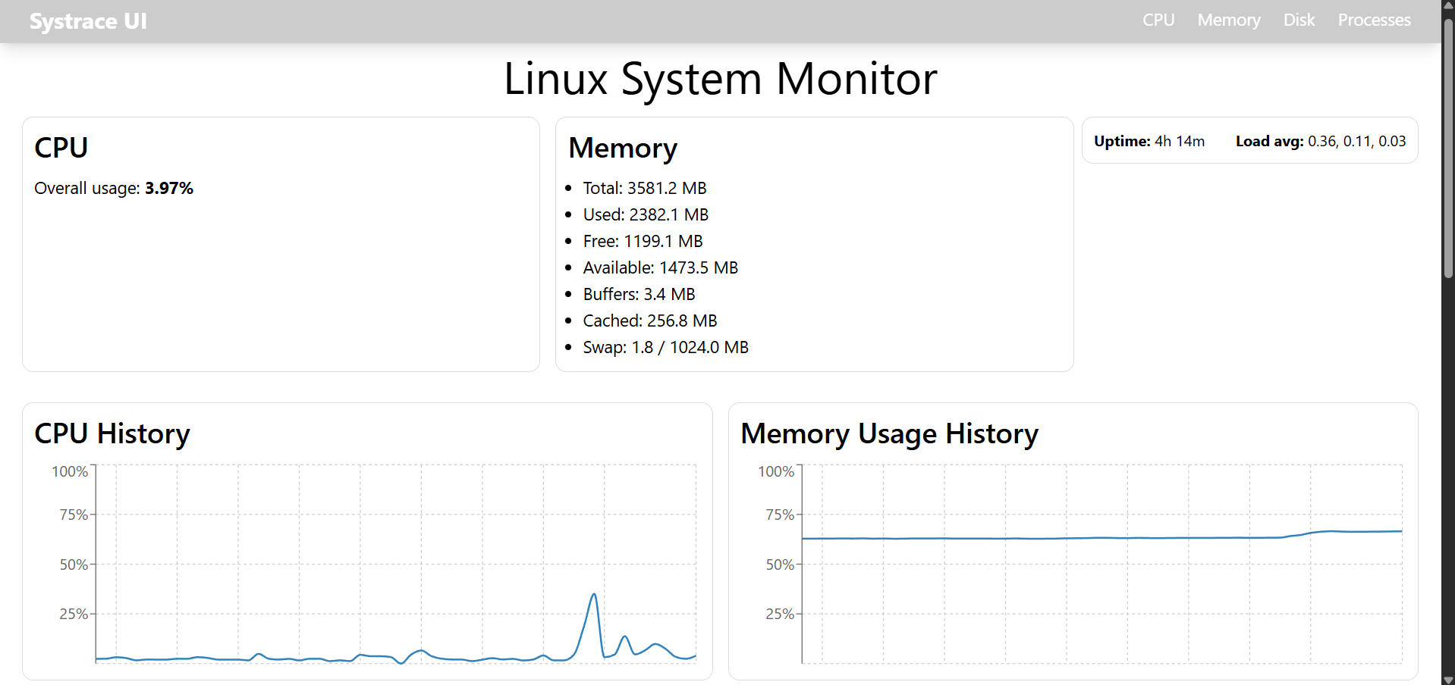
App Walkthrough
– CPU & Memory

Slide 14
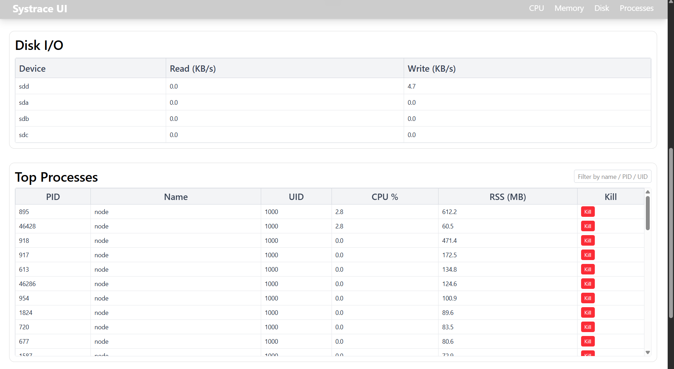
App Walkthrough
Disk I/O & Processes

Slide 15
Future Enhancements
GPU usage monitoring: Implement functionality to also monitor GPU usage.
Network statistics: Showing network stats using /proc/net.
Alerts on high CPU & Memory usage
Dark Mode: Add a dark theme for better user experience.
Desktop app version using Electron

Slide 16
Thank you

